Slide 1



PowerBI Assignment
View in Power BI
Last data refresh:
5/7/2026 5:14:07 AM UTC
Downloaded at:
5/7/2026 5:16:44 AM UTC

Slide 2
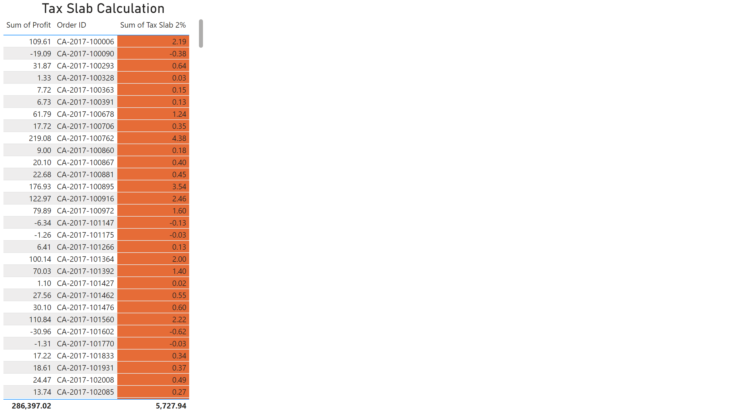
Modelling
Notes:
Tax Slab Calculation
No alt text provided

Slide 3
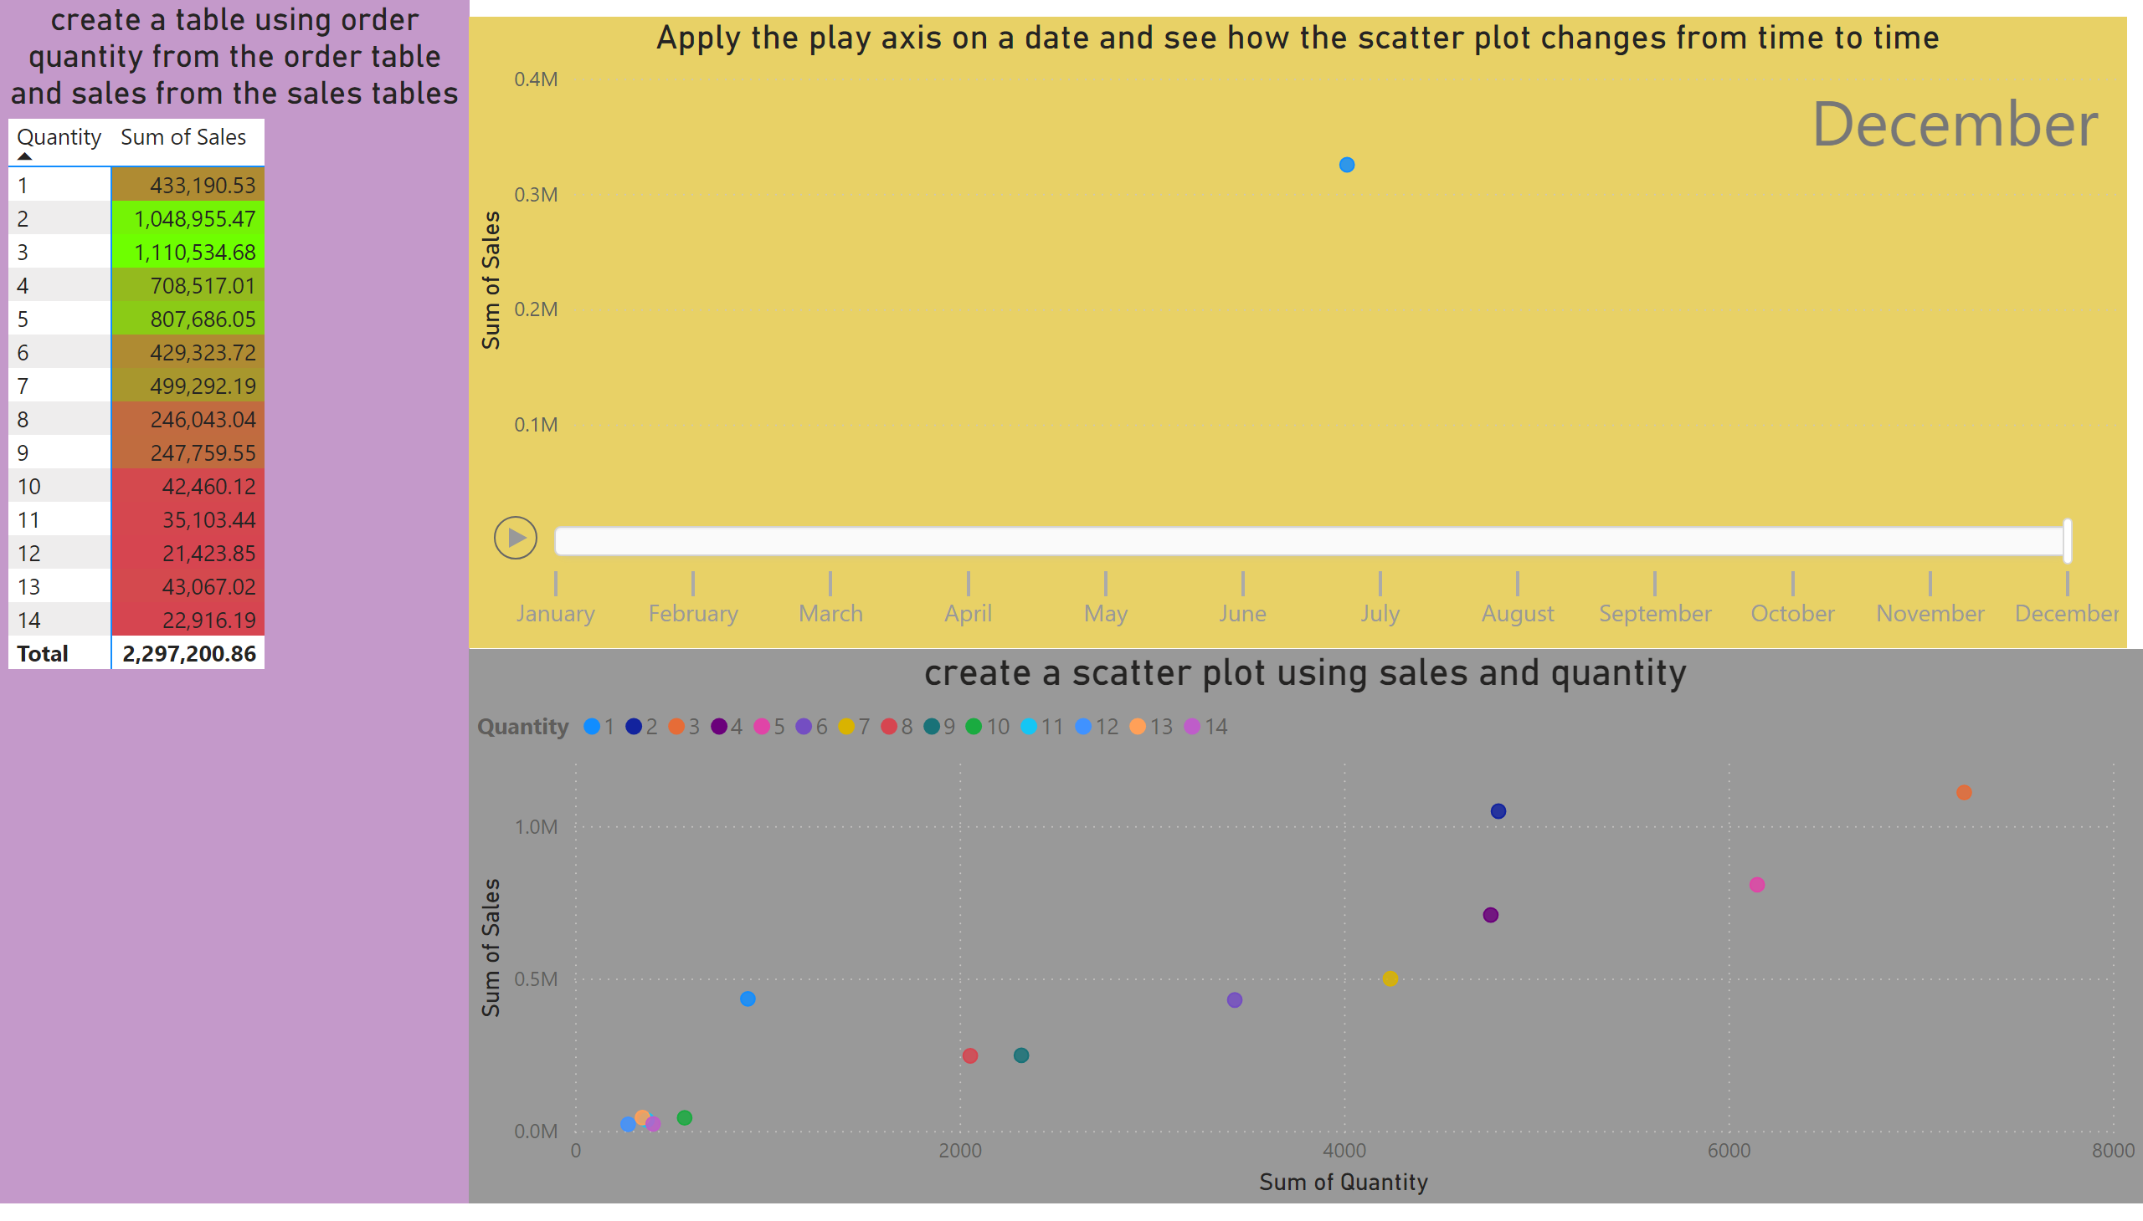
Cardinality and Desktop Visualization
Notes:
create a table using order quantity from the order table and sales from the sales tables
No alt text provided
create a scatter plot using sales and quantity
No alt text provided
Apply the play axis on a date and see how the scatter plot changes from time to time
No alt text provided

Slide 4
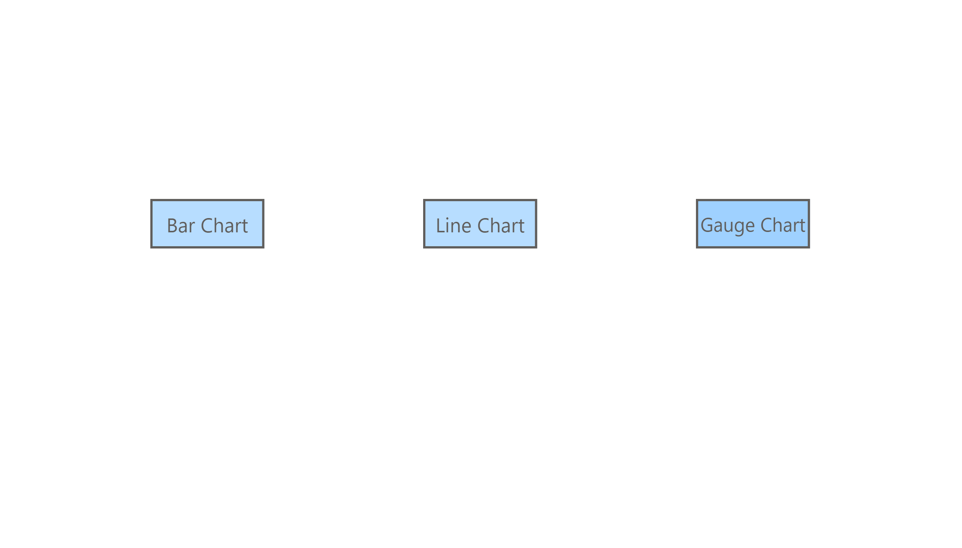
Landing Page
Notes:
actionButton
No alt text provided
actionButton
No alt text provided
actionButton
No alt text provided

Slide 5
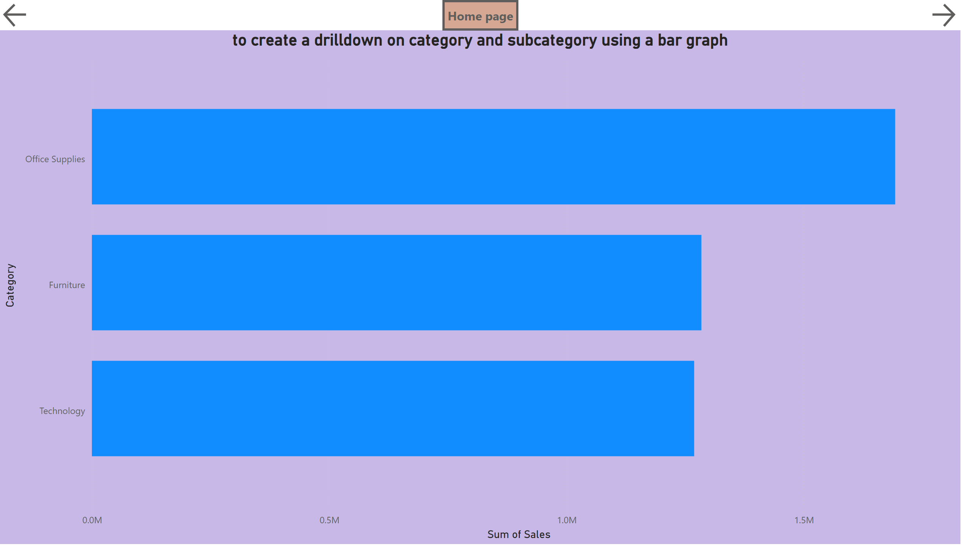
Desktop Visualization 1
Notes:
to create a drilldown on category and subcategory using a bar graph
No alt text provided
actionButton
No alt text provided
actionButton
No alt text provided
actionButton
No alt text provided

Slide 6
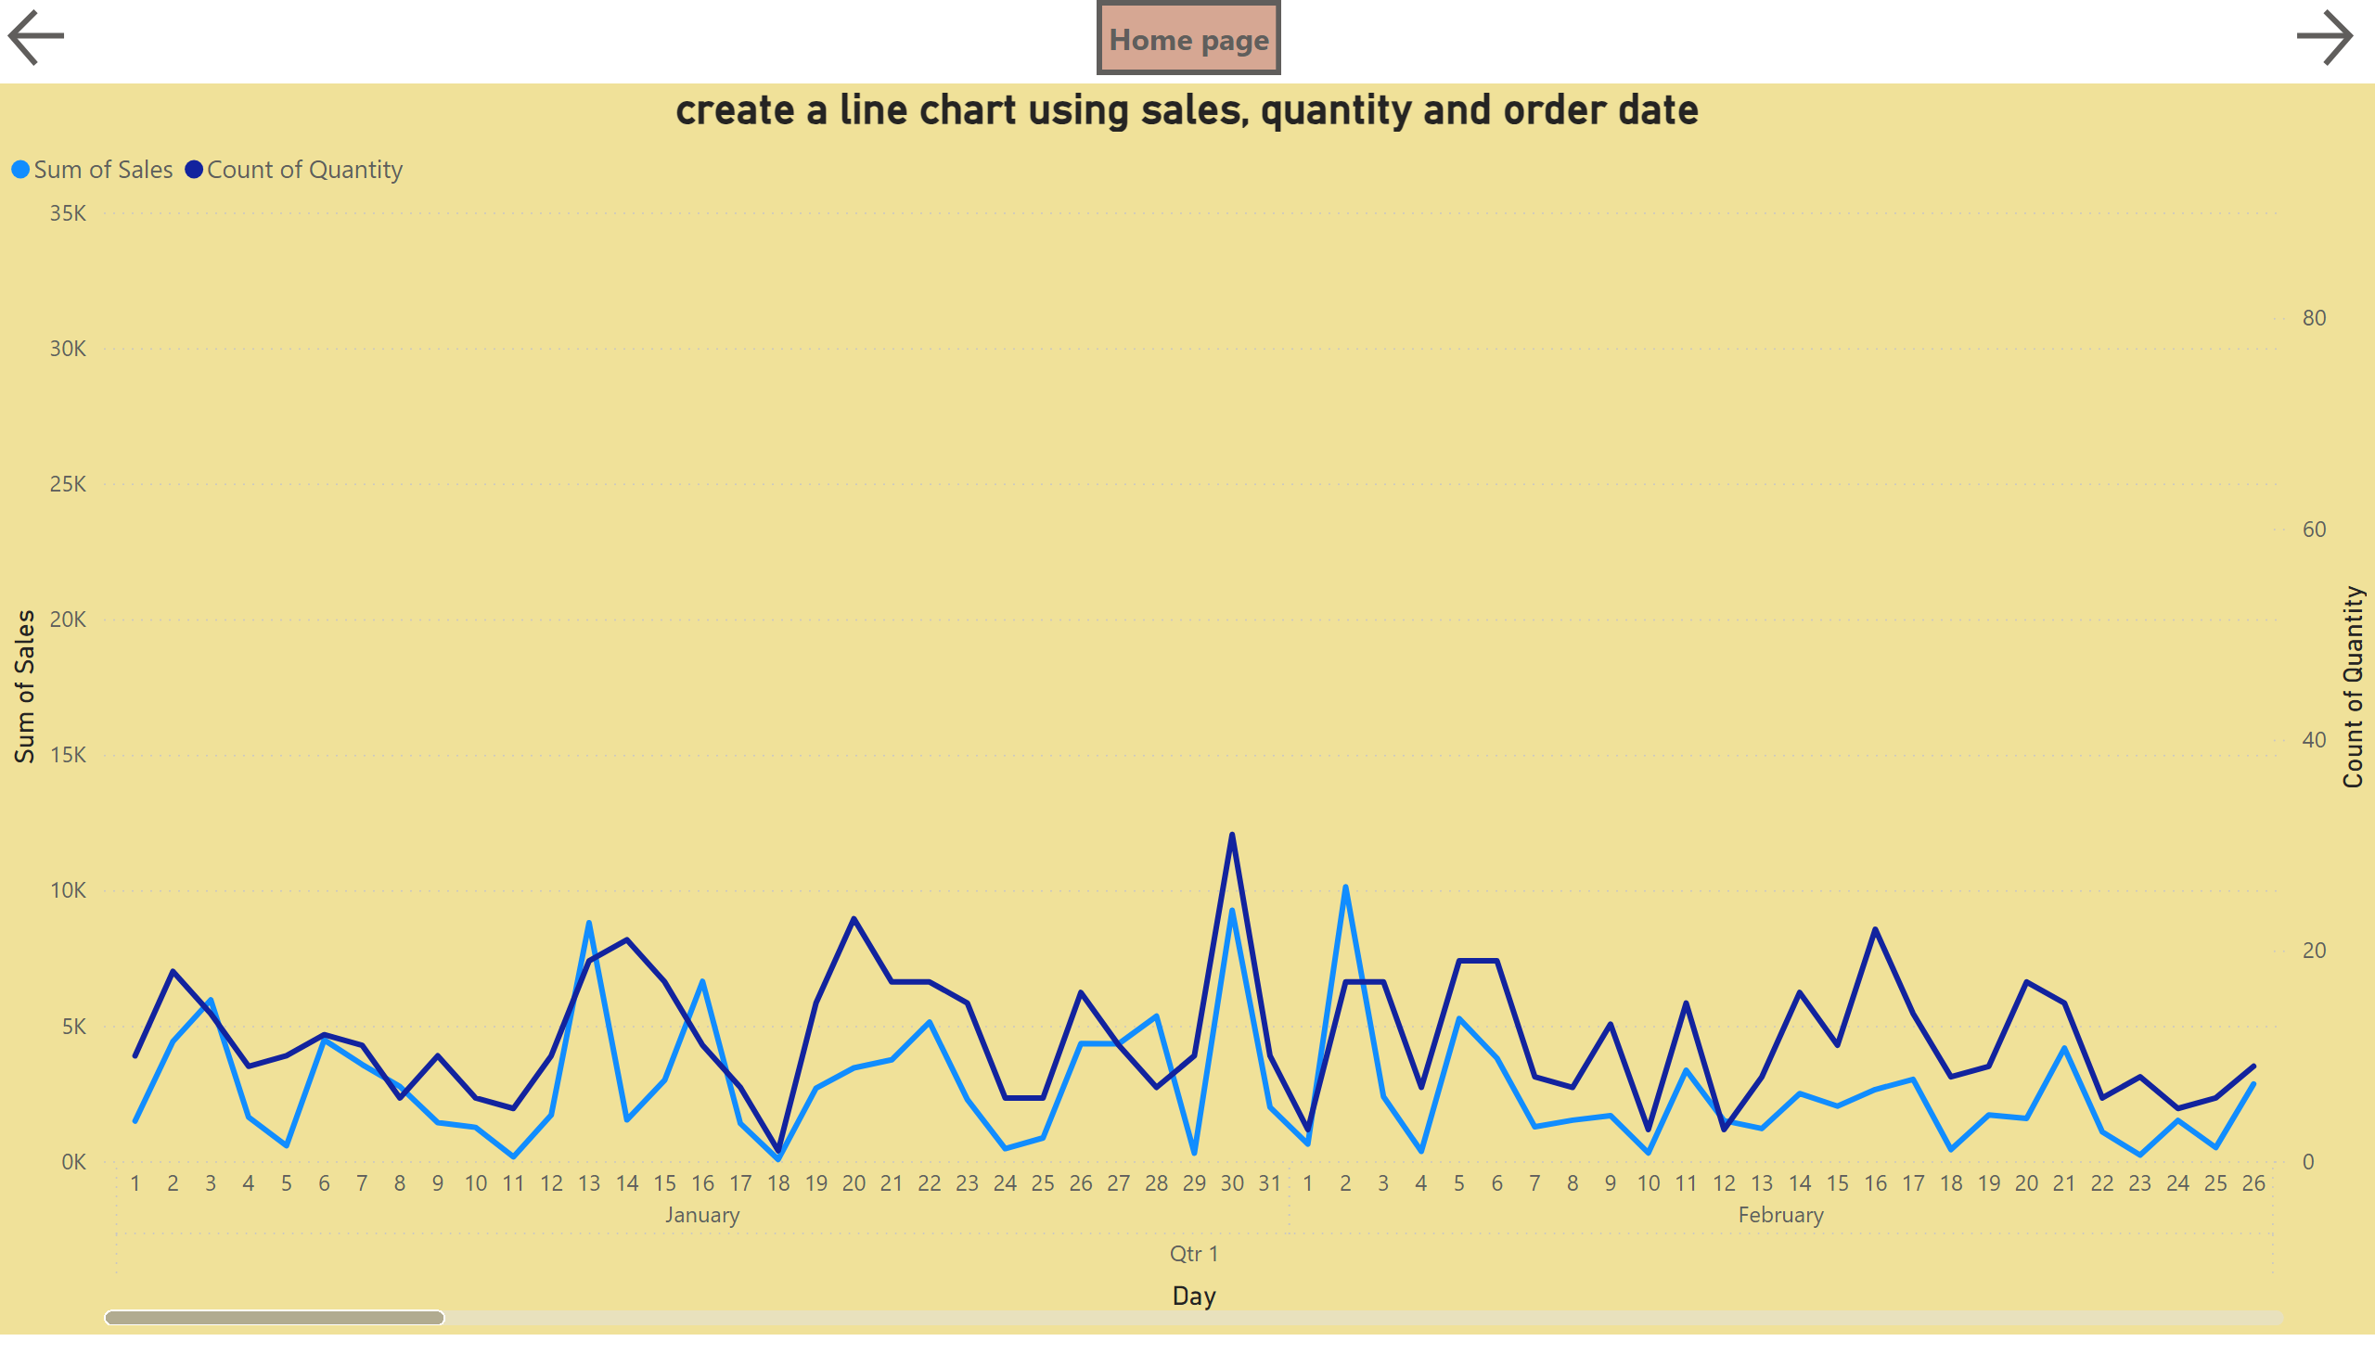
Desktop Visualization 2
Notes:
create a line chart using sales, quantity and order date
No alt text provided
actionButton
No alt text provided
actionButton
No alt text provided
actionButton
No alt text provided

Slide 7
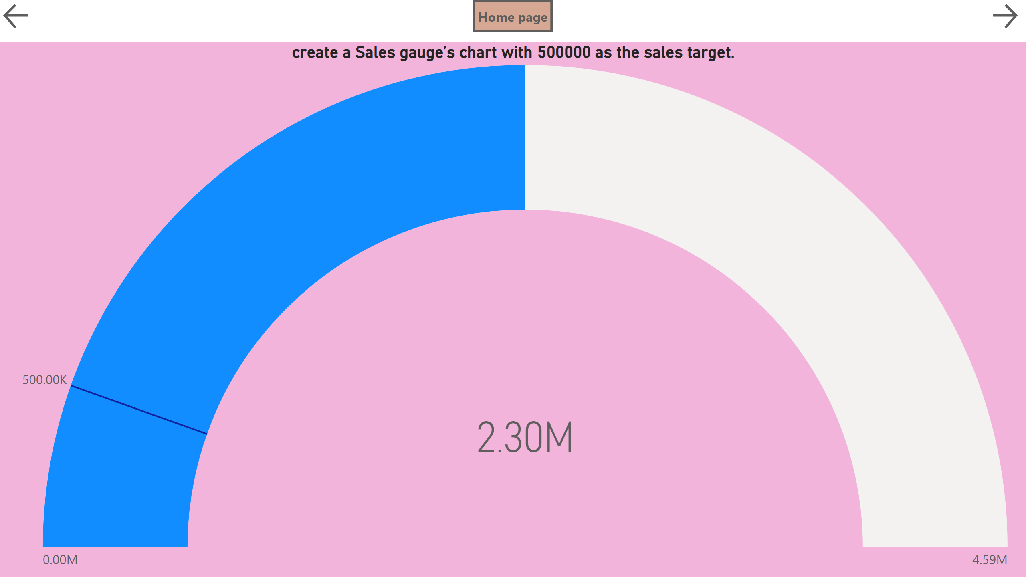
Desktop Visualization 3
Notes:
create a Sales gauge’s chart with 500000 as the sales target.
No alt text provided
actionButton
No alt text provided
actionButton
No alt text provided
actionButton
No alt text provided

Slide 8
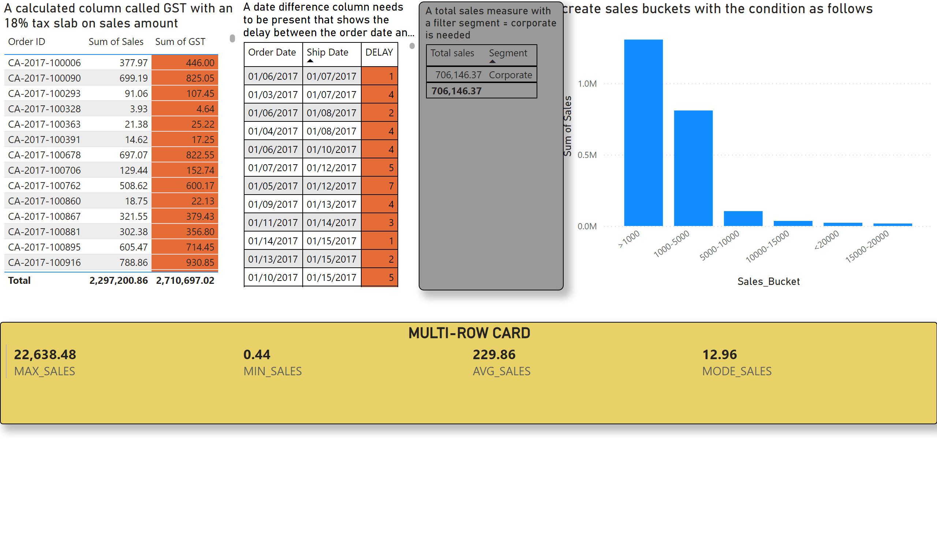
DAX Expressions Part1
Notes:
A calculated column called GST with an 18% tax slab on sales amount
No alt text provided
A date difference column needs to be present that shows the delay between the order date and the ship date.
No alt text provided
create sales buckets with the condition as follows
No alt text provided
A total sales measure with a filter segment = corporate is needed
No alt text provided
MULTI-ROW CARD
No alt text provided

Slide 9
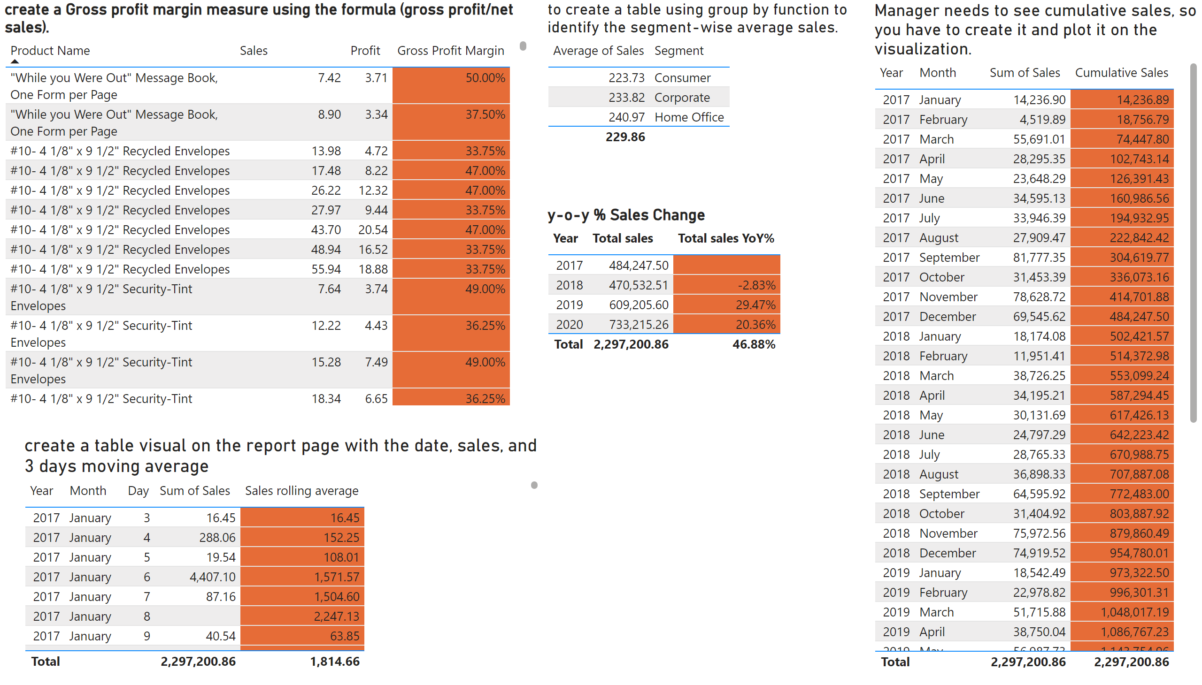
DAX Expressions Part2
Notes:
create a Gross profit margin measure using the formula (gross profit/net sales).
No alt text provided
to create a table using group by function to identify the segment-wise average sales.
No alt text provided
Manager needs to see cumulative sales, so you have to create it and plot it on the visualization.
No alt text provided
create a table visual on the report page with the date, sales, and 3 days moving average
No alt text provided
y-o-y % Sales Change
No alt text provided

